Slide 1
Agenda
Session 1 – Introduction to the Universal Windows Platform for Developers
Overview of Universal Windows Platform
Universal App Platform for Windows 10 Devices
Write Once - Deploy to Every Windows Device
Overview of Universal Apps
How are they different from conventional Win32 apps
Universal Windows App Development Tools
Overview of the Development Tools for Windows 10
Windows 10 Tools / SDKs and Emulators

Slide 2
Agenda
Session 2 - Building Apps for Windows 10
Overview of Universal App Model
New APIs for Windows 10
(Cortana, Device-specific extensions, various Nuget packages, etc)
Migration & Bridges
Strategies for Migrating Apps from other platforms
Overview of the various Bridges that can be used to partially automate the migration
Convert Web Applications into Windows Applications with Hosted Web Apps

Slide 3
Agenda
Session 3 - Building Apps for Windows 10
Session 3 - Edge for Developers - 60 minutes
Overview of Edge Capabilities and Features
Overview of Cross-Browser Testing tools
Tools on modern.ie
Quick site scan, Screenshot generator, VMs, etc
What developers need to know
HTML5 (and related technologies) support
Compatibility
"Enterprise Mode"

Slide 4
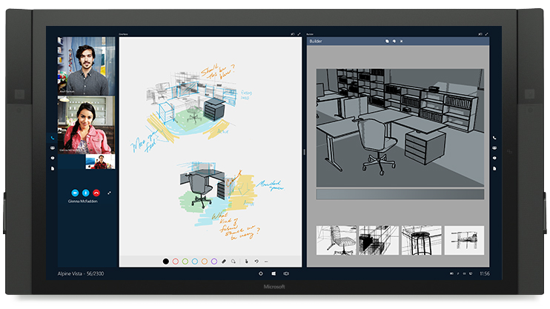
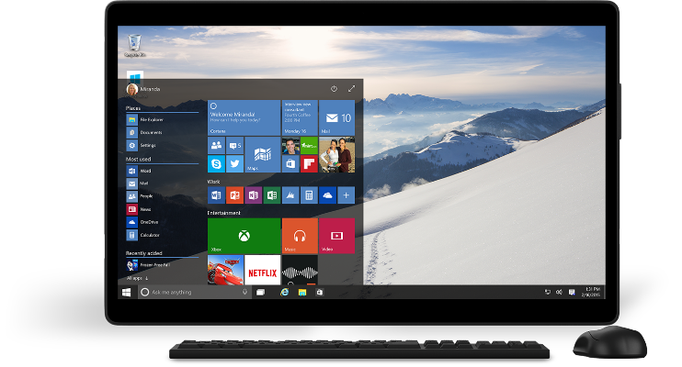
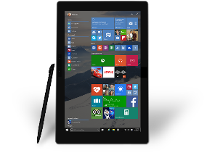
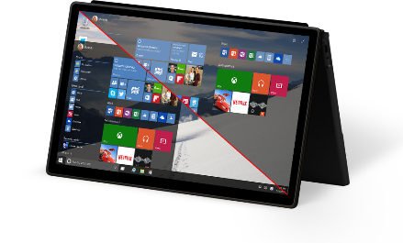
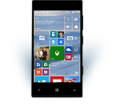
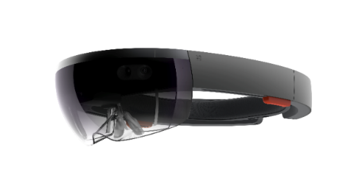
The Windows 10 opportunity
Windows Developer Platform
Growing Reach with Universal Windows Apps
Improving User Engagement
Capitalize on Massive Adoption – 110 MM installs since July

Slide 5
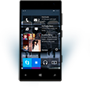

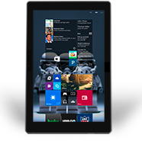
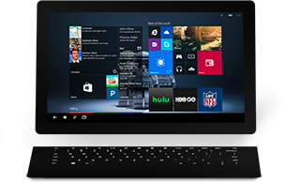

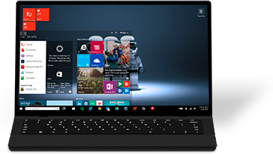

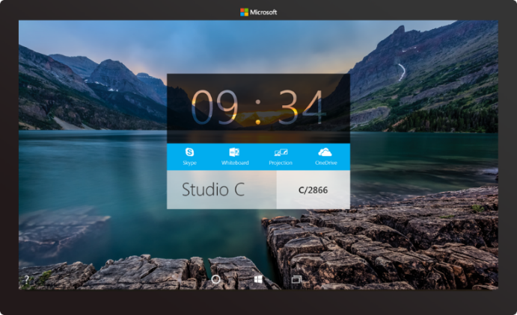

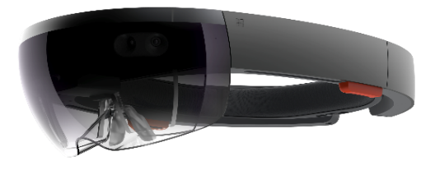



2-in-1s (Tablet or Laptop)
Classic Laptop
Desktops & All-in-Ones
Phone
Phablet
Small Tablet
Large Tablet
110 Million Consumer installations sin
Windows 10
Surface Hub
Xbox
Holographic
IoT

Slide 6

UWP Repositories
Github
https://github.com/Windows-XAML/201505-MVA/
https://github.com/Win10DevGuideMVA/ProjectUpgradeUtility/
https://github.com/Microsoft/Windows-universal-samples/
MVA
Microsoft Player Framework v3.0 BETA
Smooth Streaming Client SDK for Windows 10 >> Coming soon (week or so)
Design Guidance & Tools
Design UWP apps

Slide 7
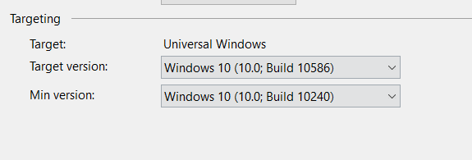
Universal Windows Platform
A single API surface
A guaranteed API surface
Your app depends on API versions, Not Windows Versions
The same on all devices
Universal Windows Platform
Windows Core
Desktop
Device
Phone
Device
Xbox
Device
Notes:
DEMO A SEGUIR!!!!!

Slide 8
Windows Core
The refactored common core
One hardware platform
Universal hardware driver
Standard network and I/O
Desktop SKU
Phone SKU
Xbox SKU
Windows Core
Desktop
Device
Phone
Device
Xbox
Device

Slide 9
One Windows
Desktop SKU
Mobile SKU
Xbox SKU
IoT SKU
IoT headless SKU
Surface Hub SKU
Holographic SKU
PC
2 in 1
Tablet
Phablet
Phone
Xbox
Band
Raspberry Pi
Surface Hub
HoloLens
Home Automation

Slide 10
Declare Device Family Dependencies
Dependency on a single device family:
<Dependencies>
<TargetDeviceFamily Name="Windows.Universal" minVersion="10.0.10069.0" maxVersionTested="10.5.0.0" />
</Dependencies>
On more than one:
<Dependencies>
<TargetDeviceFamily Name="Windows.Desktop" minVersion="10.0.10069.0" maxVersionTested="10.5.0.0" />
<TargetDeviceFamily Name="Windows.Universal" minVersion="10.0.10069.0" maxVersionTested="10.5.0.0" />
</Dependencies>

Slide 11
Adapt to different devices without targeting each and every device

Slide 12


Adaptive controls

Slide 13
How to set the visual state
VisualStateManager.Goto(element, state, transition)
public MainPage()
{
this.InitializeComponent();
this.SizeChanged += (s, e) =>
{
var state = "VisualState000min";
if (e.NewSize.Width > 1000)
state = "VisualState1000min";
else if (e.NewSize.Width > 800)
state = "VisualState800min";
else if (e.NewSize.Width > 500)
state = "VisualState500min";
VisualStateManager.GoToState(this, state, true);
};
}

Slide 14
Adaptive triggers
Code-free state transition
Two built-in triggers
MinWindowHeight (Taller than this)
MinWindowWidth (Wider than this)
<VisualState x:Name="VisualState500min">
<VisualState.StateTriggers>
<AdaptiveTrigger MinWindowWidth="501" />
</VisualState.StateTriggers>
</VisualState>

Slide 15
Custom adaptive triggers
Build to handle special cases.
public class DeviceFamilyTrigger : StateTriggerBase
{
private string _deviceFamily;
public string DeviceFamily
{
get { return _deviceFamily; }
set
{
var qualifiers = Windows.ApplicationModel.Resources.Core
.ResourceContext.GetForCurrentView().QualifierValues;
if (qualifiers.ContainsKey("DeviceFamily"))
SetActive(qualifiers["DeviceFamily"] == (_deviceFamily = value));
else
SetActive(false);
}
}
}

Slide 16
Developers have many tools to build an adaptive UI

Slide 17
As you design
Adapt to size change
Adapt to input change
Build with effective pixels
Count on the scaling algorithm

Slide 18
What are Adaptive Apps?
Windows apps adapt to different versions of the platform
Windows apps adapt to different types of devices
Windows apps adapt to different screen sizes
Adaptive UI handles different screens
Adaptive Code can "light up" your app to conditionally execute code only when running on specific device families and/or particular versions of platform/extension APIs
Conditionally take advantage of unique device capabilities
Use newer APIs while still supporting down-level clients

Slide 19
Looking back to Windows 8.1

Slide 20
Windows 8.1 Universal: Shared code, two binaries
Windows Binary
Phone Binary

Slide 21
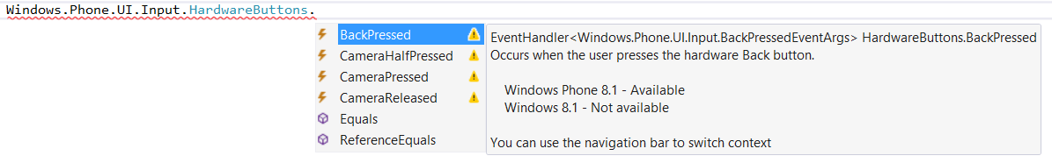
Not all APIs were available everywhere

Slide 22
Compilation directives
C# Syntax
#if WINDOWS_PHONE_APP Windows.Phone.UI.Input.HardwareButtons
.BackPressed += this.HardwareButtons_BackPressed; #endif
C++ Syntax
#if WINAPI_FAMILY==WINAPI_FAMILY_PHONE_APP _backPressedEventToken = HardwareButtons
::BackPressed += ref new EventHandler <BackPressedEventArgs^> (this,
&NavigationHelper::HardwareButton_BackPressed); #endif

Slide 23
Platform Extensions

Slide 24
UAP
UAP
UAP
UAP
Windows Core
Windows Core
Windows Core
Windows Core
Desktop
Mobile
Xbox
More…

Slide 25
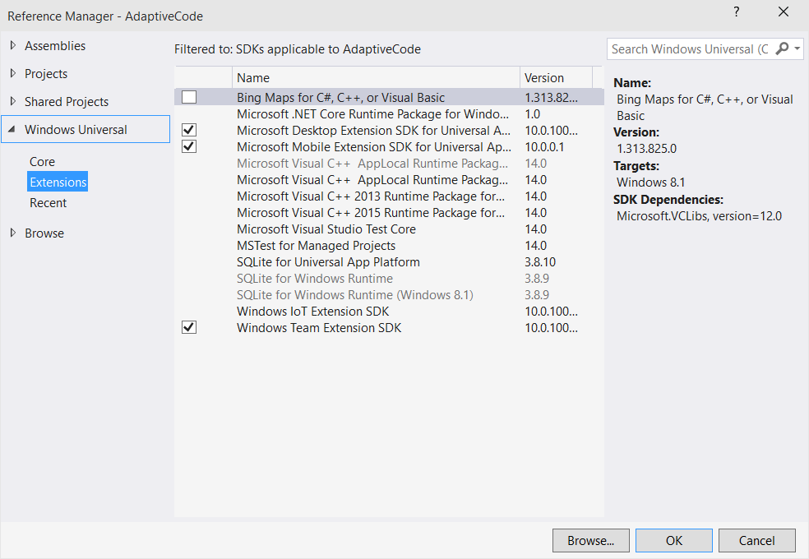
Platform extensions
Device-specific API
Family-specific capabilities
Compatible across devices
Unique update cadence
Windows App
Desktop
extension
Phone
extension
Xbox
extension
Universal Windows Platform
Windows Core
Desktop
Device
Phone
Device
Xbox
Device

Slide 26
Test capabilities at runtime
Use Adaptive Code to light-up your app on specific devices
var api = "Windows.Phone.UI.Input.HardwareButtons";
if (Windows.Foundation.Metadata.ApiInformation.IsTypePresent(api))
{
Windows.Phone.UI.Input.HardwareButtons.CameraPressed += CameraButtonPressed;
}

Slide 27
Testing for capabilities
Windows.Foundation.Metadata.ApiInformation
IsApiContractPresent
IsEnumNamedValuePresent
IsEventPresent
IsMethodPresent
IsPropertyPresent
IsReadOnlyPropertyPresent
IsTypePresent
IsWriteablePropertyPresent
Notes:
DEMO A SEGUIR!!!!

Slide 28
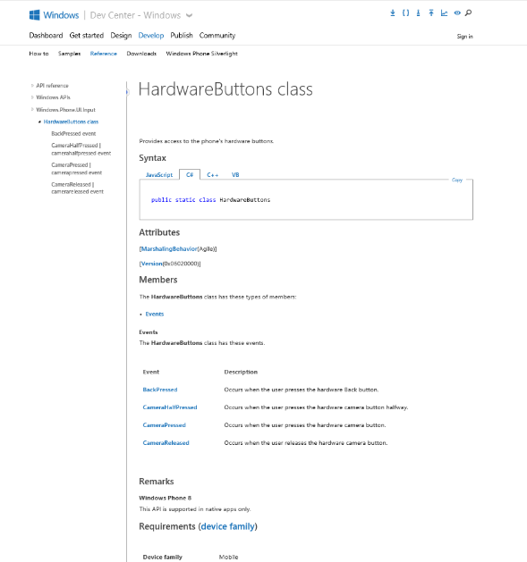
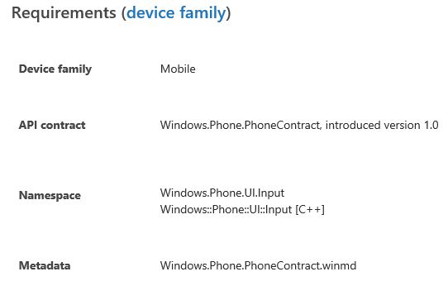
Identifying the Extension SDK
MSDN docs:

Slide 29

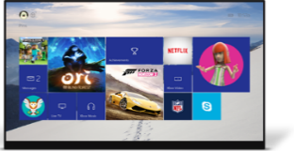
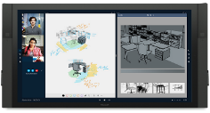
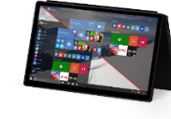

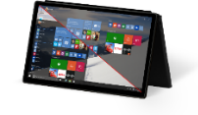
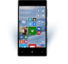
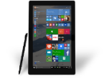
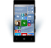











PC
XBox
Mobile
Surface Hub
Devices +IoT
HoloLens
Universal Windows Apps
Multiple device families
Adaptive User Interface
Reuse Existing Code
Natural User Inputs
One Store + One Dev Center
One SDK + Tooling
One Universal Windows Platform

Slide 30
Developing Universal Windows Apps in Visual Studio 2015

Slide 31
WPF
WF
MFC
XAML
HTML
Bridging technologies
Obj.C
iOS
Java
Android
Web
hosted
Win32
desktop
DirectX
.Net
languages
C++
.Net
languages
C++
& CX
WWA
.Net
runtime
Universal Windows Platform
Windows 10
operating system

Slide 32
Universal Windows App Development Tools
Visual Studio 2015 Update 1 with
Install Windows 10 Update 1) Released Nov 12)
Install VS 2015 Update 1 w/ Universal Windows SDK & Tools
www.visualstudio.com
Build your first Universal Windows App
Notes:
What is new in Windows 10 Update 1?
From Jerry Nixon’s Blog:
Get it in your head that update 1 is a fit and finish release. The developer story was already good. Now it’s even faster and more stable. Although Windows 10 update 1 has several consumer-oriented user delight features, like Windows Hello, the UWP side of things is pretty stable. We’re basically leaving significant innovations to our next release, codenamed Redstone.

Slide 33
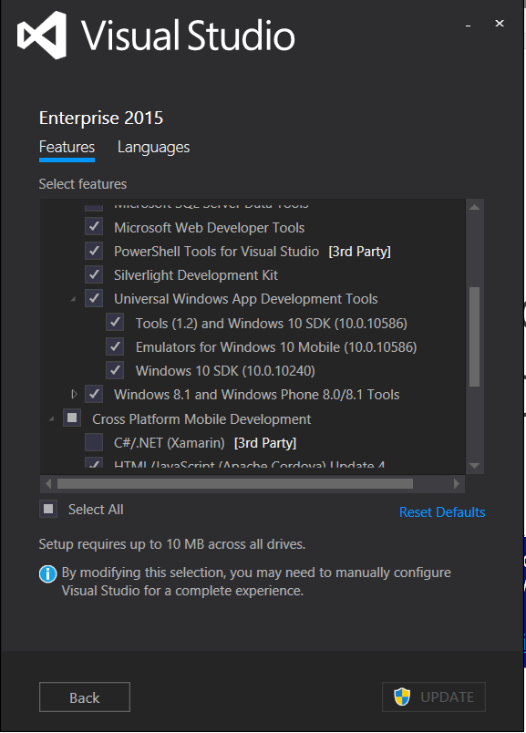
Acquiring Windows 10 Tools/SDKs/Emulators
Select “Universal Windows App Development Tools” using Custom setup option

Slide 34
Universal Windows Platform
Mobile
Desktop
Unified Developer Platform
Single Application Package
Adaptive Code
Universal Windows Platform
Core APIs
IoT
Xbox
Holographic
Surface Hub

Slide 35

Universal Windows Platform
Wherever your code was born, you can bring it to Windows
Windows Platform
Web Platform
Universal Windows 8 Apps (C++/C#/JS)
Microsoft Edge HTML Engine
Universal Windows 10 Apps (C++/C#/JS)
Surface Hub
Desktop
Cordova Tooling (HTML/JS)
Project Centennial (Classic Apps)
Hosted Web Apps (HTML/JS)
Universal Windows Platform
IoT
Xbox
Middleware Platforms
Other Mobile Platforms
Middleware Partners (e.g., Xamarin)
Holographic
Mobile
Project Astoria (Java/C++)
Game Engine Partners (e.g., Unity)
Project Islandwood (Objective C/C++)

Slide 36
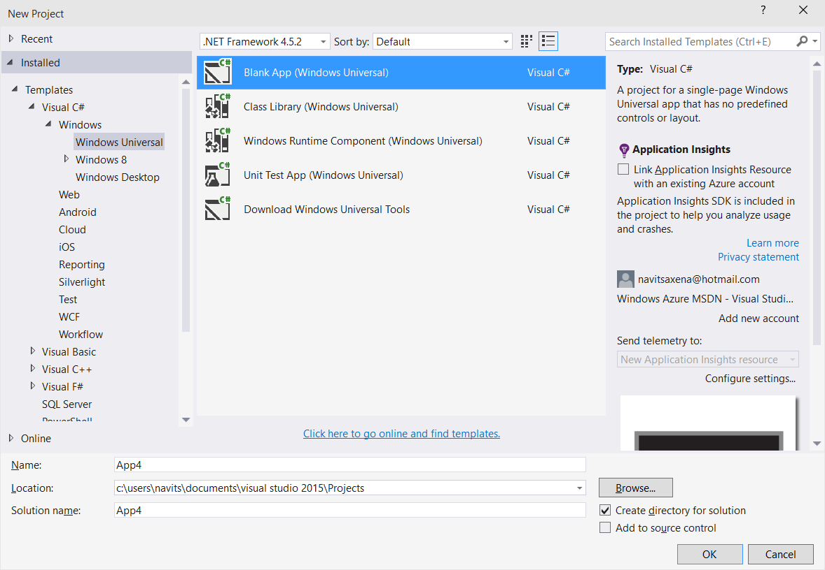
Project Templates

Slide 37
Demo: HelloWorld Universal App & Adaptive Code
Notes:
https://msdn.microsoft.com/library/windows/apps/dn765018.aspx

Slide 38
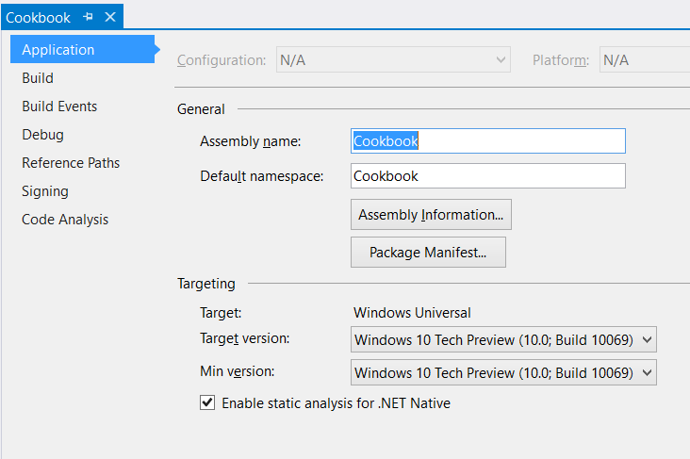
Project Properties
Target version (TargetPlatformVersion)
Defines the version of Universal Windows SDK being targeted by project
Defines the available API surface for the application
Is stamped as TargetDeviceFamily.MaxVersionTested property in the AppX manifest file as part of the build process
<Dependencies>
<TargetDeviceFamily
Name="Windows.Universal" MinVersion="10.0.10069.0" MaxVersionTested="10.0.10069.0" />
</Dependencies>

Slide 39
Project Properties
Min version (TargetPlatformMinVersion)
Defines the minimum version of Universal Windows platform being supported by the project (adaptive application package)
Is stamped as TargetDeviceFamily.MinVersion property in the AppX manifest as part of the build process
<Dependencies>
<TargetDeviceFamily
Name="Windows.Universal" MinVersion="10.0.10069.0" MaxVersionTested="10.0.10069.0" />
</Dependencies>

Slide 40
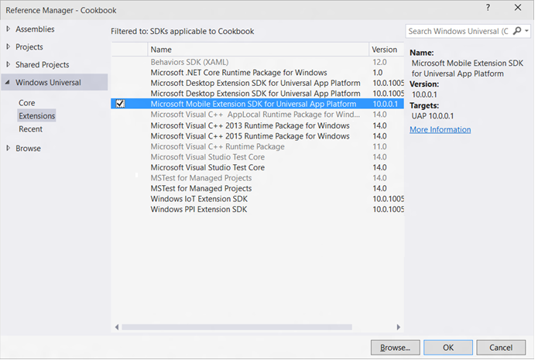
Windows Device Family Extension SDKs
Use device family specific APIs by adding references to Windows Device Family Extension SDKs

Slide 41
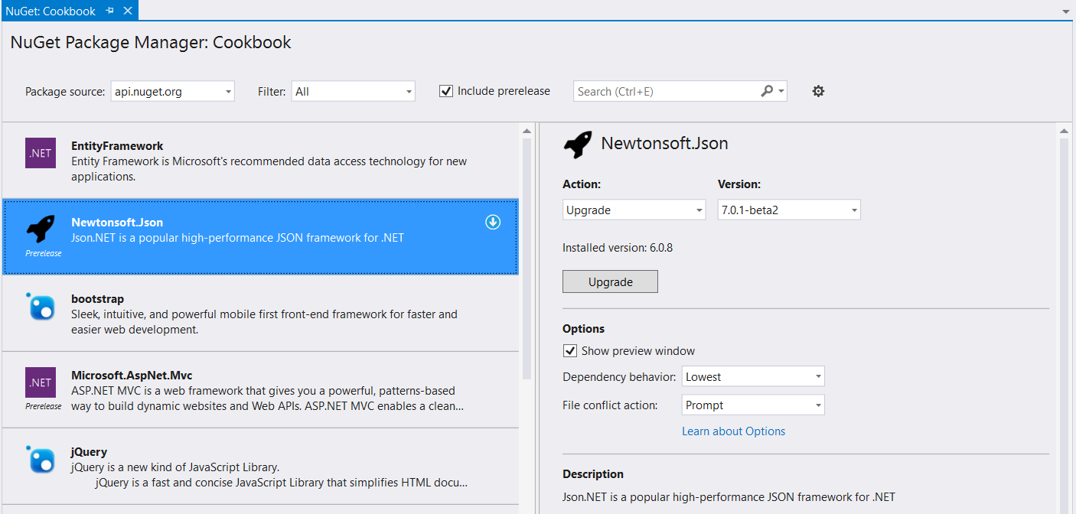
NuGet
Universal Windows apps support referencing NuGet packages

Slide 42
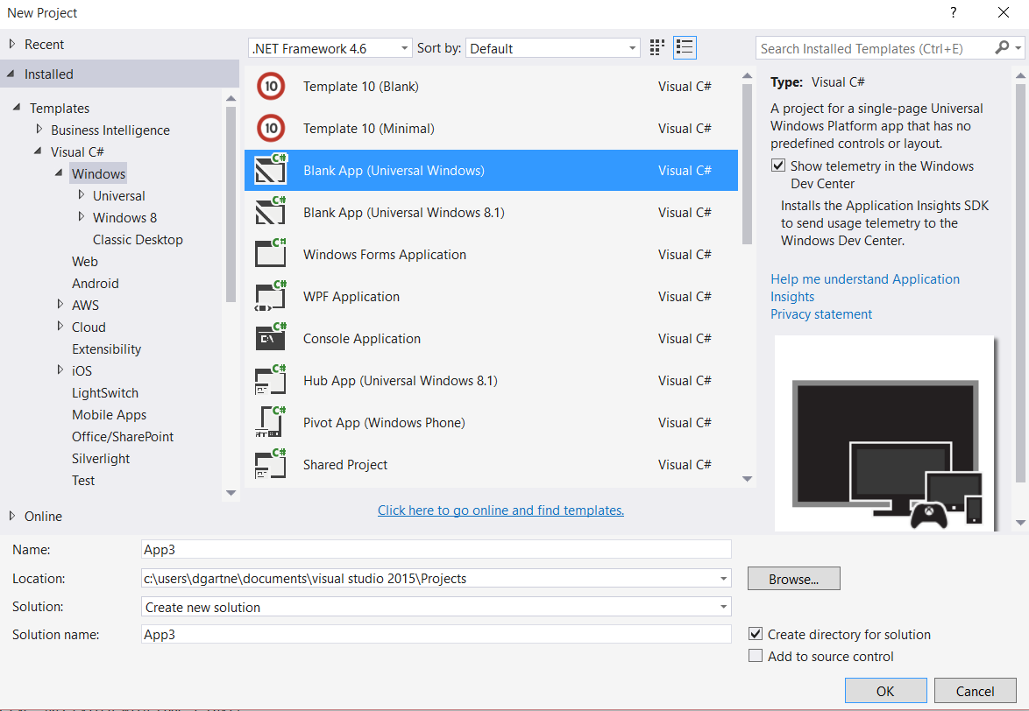
App Insights
App Insights enable developers to monitor app’s performance and usage statistics
Universal Windows project templates are enabled for App Insights and monitors app users, sessions, page view, crashes and real time usage without writing any additional code
Developers can easily add custom events to collect additional telemetry data for the app

Slide 43
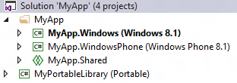
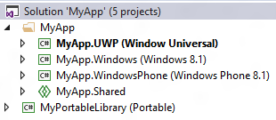
Universal 8.1 App
Upgrade Windows/Windows Phone 8.1 projects
Add single Universal Windows project to target different Windows 10 devices
Use Adaptive code for device family specific APIs
Use Adaptive UI to support different form factors
Use Shared projects, WinRT components, PCLs to share code between Universal Windows, Windows 8.1 and WP 8.1 projects
1: Single Universal Windows Project

Slide 44
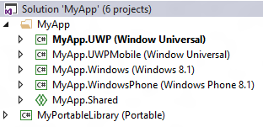
Universal 8.1 App
Add a new Universal Windows project to target a specific Windows 10 device (ex: Mobile)
Update Package.appxmanifest to include “Windows.Mobile” device family with matching MinVersion/MaxVersionTested
<Dependencies>
<TargetDeviceFamily
Name="Windows.Mobile"
MinVersion=“<Windows.Mobile MinVersion>“
MaxVersionTested=“<Windows.Mobile MaxVersionTested>"/>
</Dependencies>
Add a new Universal Windows project to target other Windows 10 devices
Use Shared projects, WinRT components, PCLs to share code between Universal Windows, Windows 8.1 and WP 8.1 projects
2: Different project/package for a device family

Slide 45
Resources
Windows 10 Samples
Developer Assistant for Visual Studio
http://aka.ms/devassistant
https://github.com/Microsoft/Windows-universal-samples

Slide 46
Agenda
Session 2 - Building Apps for Windows 10
Overview of Universal App Model
New APIs for Windows 10
(Cortana, Device-specific extensions, various Nuget packages, etc)
Migration & Bridges
Strategies for Migrating Apps from other platforms
Overview of the various Bridges that can be used to partially automate the migration
Convert Web Applications into Windows Applications with Hosted Web Apps

Slide 47
Why do we need an app model?
Windows has never had a definition of an app
You know it when you see it but it’s never written down
Started with .exe but…
How do you install it?
How do you store state?
How long does the app run for?
What’s the versioning story?
How do you integrate with the OS?
How do you integrate with other apps?
What can your app do?
The UWP App Model provides answers to these questions

Slide 48
What is the UWP Windows App Model
Defines the app lifecyle
Unified across all Windows devices
Scales from IOT→Mobile→PC→Xbox→Hololens
Cradle to Grave
Install
Runtime environment
Resource Management
Update
Data Model
Uninstall

Slide 49
UWP App Model
Inclusive of all apps that run on Windows
Universal Windows Apps
Existing apps
Phone Apps
Windows 8.1 Apps
Classic Windows Apps

Slide 50
What does the app model mean?
AppX is the deployment model
Putting MSI on notice
Provides a better way to install/uninstall/update
Runtime isolates registry/disk access
Enforces App Model Policy
Integrate into the new app model

Slide 51
Getting your app
User promise:
Never regret installing an app
Where do I get the app from?
Store is the default place to get apps
Flexible deployment
Based on the phone model
Token enrolled on device then any app signed with that token can be installed from anywhere
AppX improvements
Size – support >150Gb

Slide 52
Windows 10 Bridges

Slide 53
Universal Windows Platform
Wherever your code was born, you can bring it to Windows
Windows Platform
Web Platform
Universal Windows 8 Apps (C++/C#/JS)
Microsoft Edge HTML Engine
Universal Windows 10 Apps (C++/C#/JS)
Surface Hub
Desktop
Cordova Tooling (HTML/JS)
Project Centennial (Classic Apps)
Hosted Web Apps (HTML/JS)
Universal Windows Platform
IoT
Xbox
Middleware Platforms
Other Mobile Platforms
Middleware Partners (e.g., Xamarin)
Holographic
Mobile
Project Astoria (Java/C++)
Game Engine Partners (e.g., Unity)
Project Islandwood (Objective C/C++)

Slide 54
Universal Apps Bridges
Project Islandwood – Compiling Objective-C
Project Westminster – Hosted Web Apps and Web Platform
Project Astoria – Build Windows Apps with your Android Code
Project Centennial – Convert your Classic Windows Apps to a Universal Windows App

Slide 55
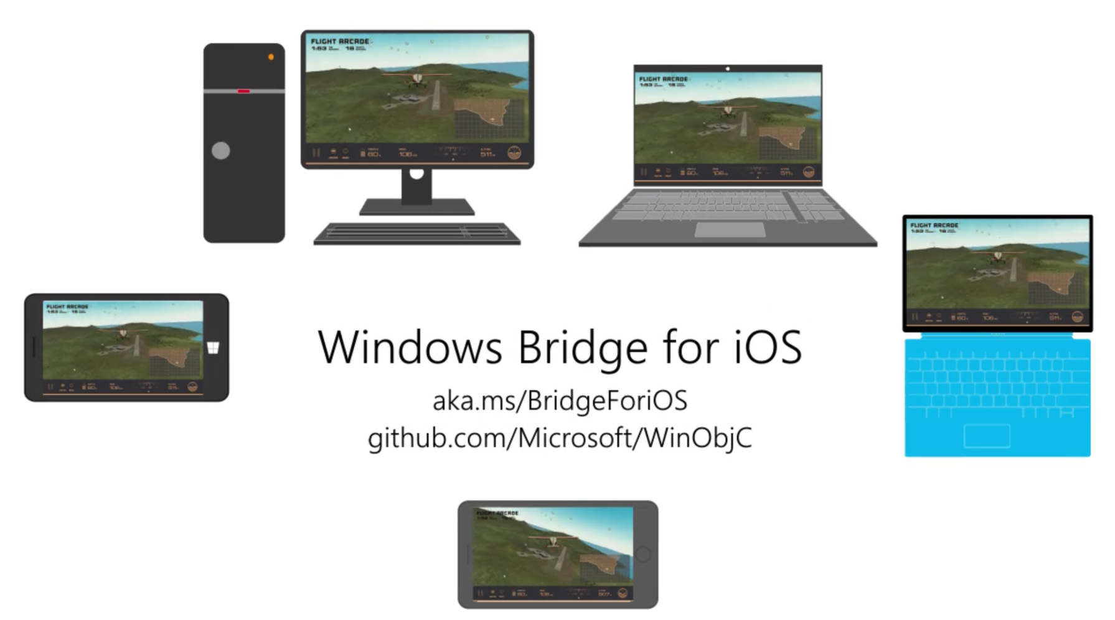
Project Islandwood
Notes:
https://dev.windows.com/en-us/bridges/ios

Slide 56
Write Universal Windows Apps in Objective-C
What is Project Islandwood?
Objective-C language support
Compiler and Runtime
Useful and usable APIs
iOS API compat
Tools
Editor / Workflow
Project import
Notes:
Compiler and runtime that builds native universal app binaries
Compability libraries that enable the use of iOS apis in Windows so you can reuse existing code
VS integration – debugging, Intellisense

Slide 57
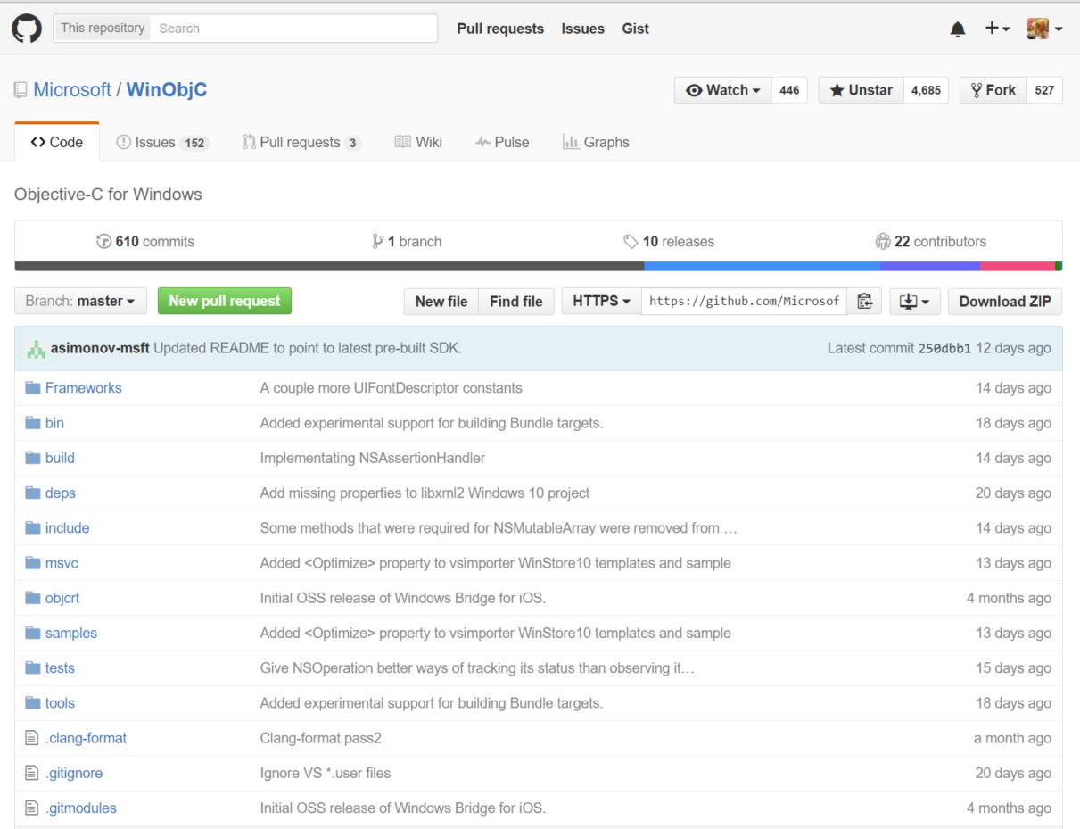
Notes:
Open source on github
https://github.com/Microsoft/WinObjC
If you need a currently unsupported API, submit a pull request or issue

Slide 58
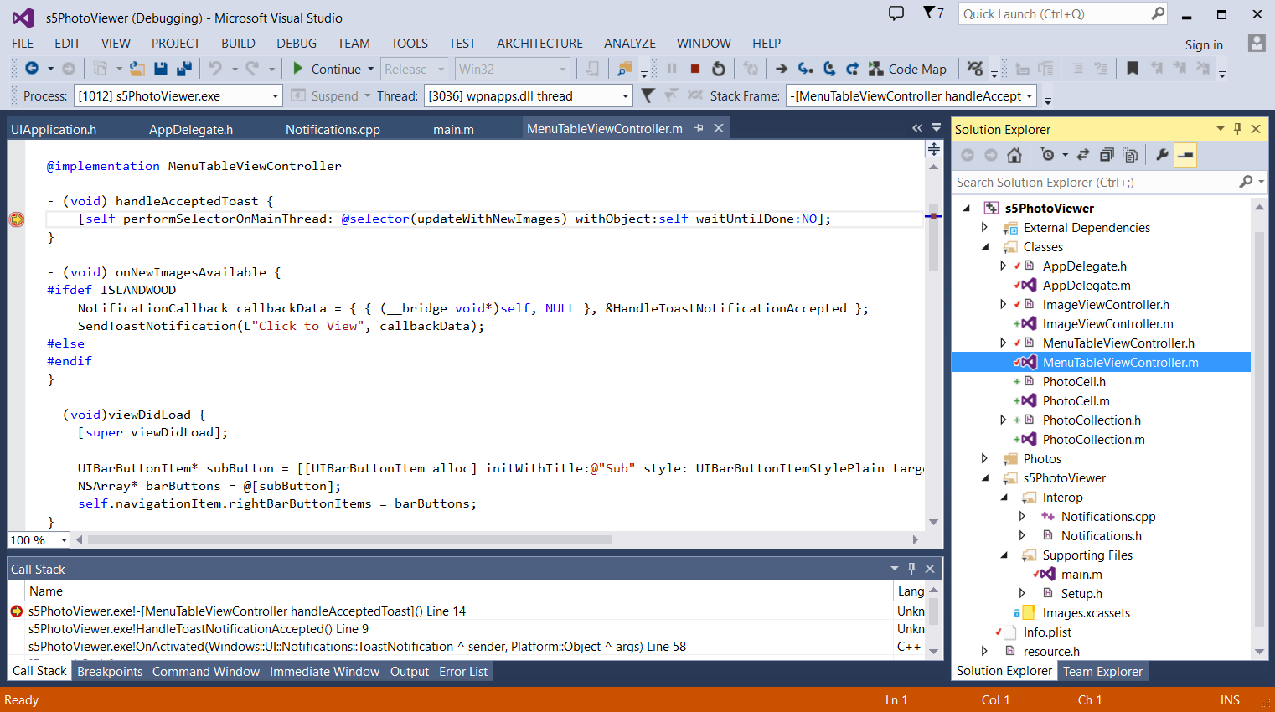
Tooling
Integrated Visual Studio Development
Integrated language support: syntax highlighting, autocomplete
Xcode projects imported to Visual Studio
Universal API Interop
Full debugging: breakpoints, stack traces, …
Notes:
All of the universal app APIs are available to you

Slide 59
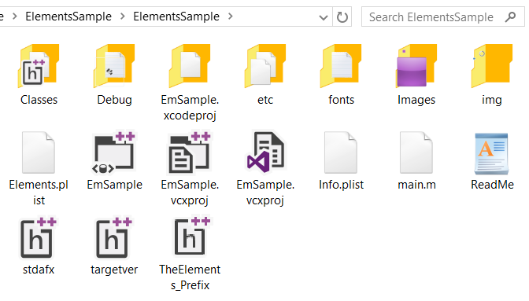
Tooling
Xcode projects imported to Visual Studio
Shared project settings, imported from Xcode

Slide 61
Demo – Converting an Objective-C app into a UWP app

Slide 62
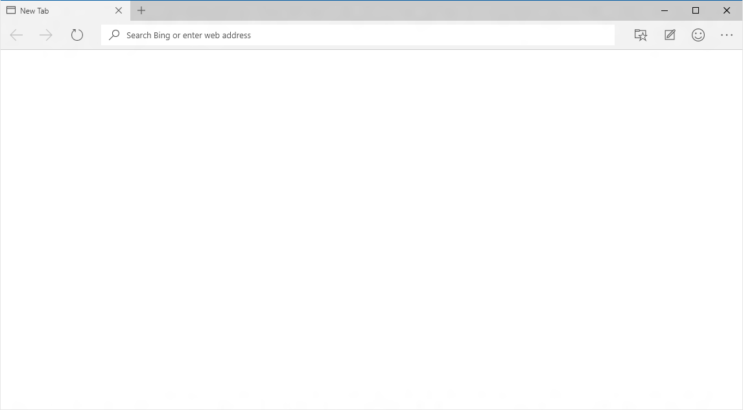
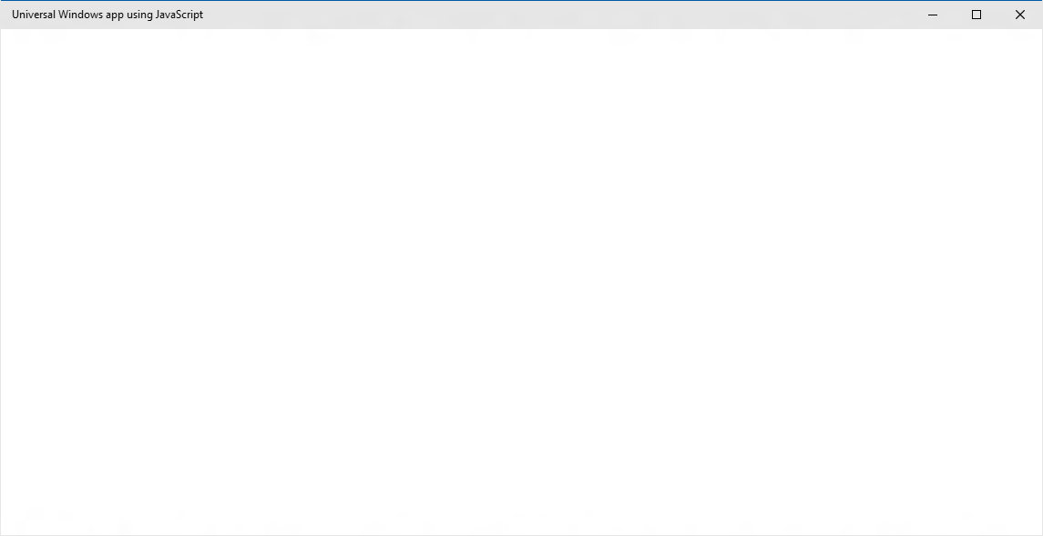
EdgeHTML.dll
Chakra
Packaged content
Offline first
Hosted content
Always up-to-date
Notes:
You web app can have full access to the Universal Windows Platform (UWP), including calling Windows Runtime APIs directly from script hosted on a server, leveraging Cortana integration, and using an online authentication provider. Hybrid apps are also supported as you can include local code to be called from the hosted script and manage app navigation between remote and local pages.

Slide 63
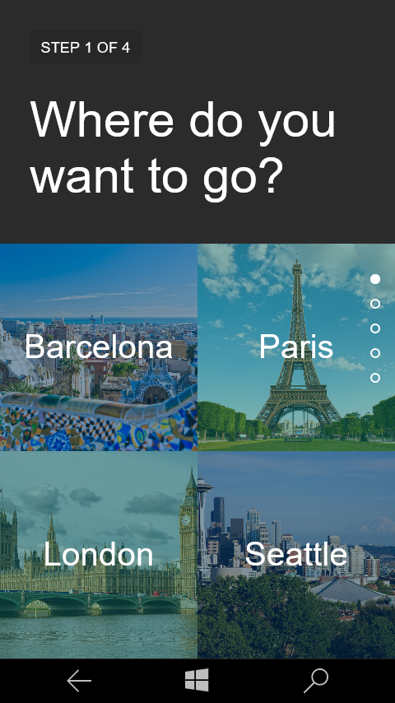
Hosted Web Apps
Keep your web workflow for updating content
Use your editor
Push to your repo’s
Deploy on your service
Reach Windows users
Code
Visual Studio
Notepad++
Brackets
Vim
ATOM
Sublime Text
Emacs
Push
Git
SVN
Visual Studio Online
GitHub
Bitbucket
Gitlab
Host
Amazon WS
Heroku
Parse
Private Cloud
Microsoft Azure
Release

Slide 64
Hosted Web Apps
XML Manifest URI Allow List (Under-the-hood)
WindowsRuntimeAccess=
"all" Match="https://*.websites.net/"
"allowForWebOnly" Match=https://*.website.net/
Developers can control the Universal APIs they want to expose
"none" Match="http://ads.website.net/"
Default is no access

Slide 65
Access the native Windows APIs
Windows Universal API access using JavaScript
Just like hosted web apps, WebView can call APIs directly from web code
if (window.Windows){
// Create an appointment with Windows.ApplicationModel.Appointments.Appointment();
}

Slide 66
Cortana Integration
Add a Voice Command Definition file on your server
Add a meta element tag in your HTML
Handle the Cortana activation in your JavaScript
<meta name="msapplication-cortanavcd" content="http://mysite.com/vcd.xml"/>" content="http://flightarcade.azurewebsites.net/vcd/vcd.xml"/>
// Add an event listener for the activation event
if (Windows.UI.WebUI.WebUIApplication.addEventListener(“activated”, function (args)) {
// Handle the Voice Command activation event
var activation = Windows.ApplicationModel.Activation;
if (args.kind === activation.ActivationKind.voiceCommand) {
// Extract the result from the speech recognition from the event arguments
var speechRecognitionResult = args.result;
// Get the recognized command, defined in the VCD file
var command = speechRecognitionResult.rulePath[0];
// Get the full string of text that was spoken
var textSpoken = speechRecognitionResult.text;
}
});

Slide 67
Hosted App Demo

Slide 68
Packaged JavaScript Apps
Native HTML5/JS apps on Windows
Copy and paste your server code locally
WebView can still navigate to remote content
Leverage the Edge rendering engine
Always up-to date
New security model using Content Security Policy
More frameworks just work

Slide 69
Default CSP is the security model for packaged apps
Default policy applied to local content
script-src ms-appx: data: 'unsafe-eval'; style-src ms-appx: data: 'unsafe-inline' object-src 'none'; font-src ms-appx: data:;
Custom policy specification available
Load local content through ms-appx-web:///
Specify policy in html page head with a metatag
<meta http-equiv="Content-Security-Policy" content="script-src ms-appx: data:”>

Slide 70
Content Security Policy Overview
Directive | Example | Controls
default-src | ‘self’ | JS, Images, CSS, Font’s, XHRs, Frames, Media
script-src | ‘self’ my.scripts.com | JS
style-src | ‘self’ my.style.com | CSS
img-src | ‘self’ my.cdn.com | <img>
connect-src | * | XHR, WebSockets
font-src | ‘self’ my.fonts.com | Fonts
object-src | ‘none’ | Plugins <object>, <embed>, <applet>
media-src | my.media.com | <audio>, <video>
frame-src | ‘self’ | URIs that iFrames can load
sandbox | allow-scripts | Enables sandbox for requested resource
report-uri | /my-report-uri.com | URI where browser posts policy violation reports

Slide 71
Summary
Web Apps are Universal Windows Apps
Hosted Web Apps allow you to leverage code on the server and enable platform integration
Packaged Apps are improved with Content Security Policy
Edge WebView gives you more granular control
ManifoldJS is the simplest way to build Hosted Apps cross platform

Slide 72
World’s most personal digital assistant helps you get things done throughout the day
A whole new natural, way of interacting with your PC
Available to millions of users across Windows 10 PCs, tablets, and phones
Integrated search across device, the Web and personal and professional clouds
A new opportunity for partners
Cortana

Slide 73
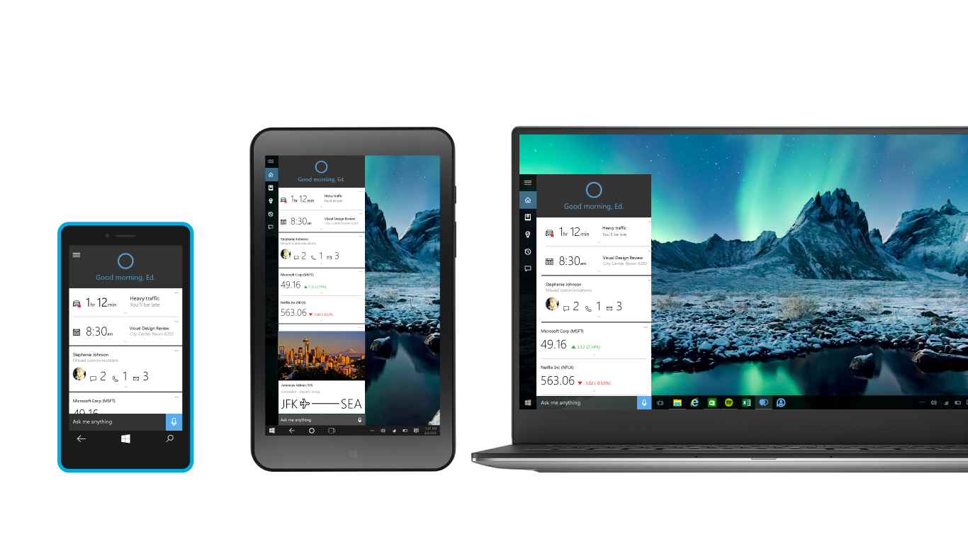
Cortana on all your screens

Slide 74
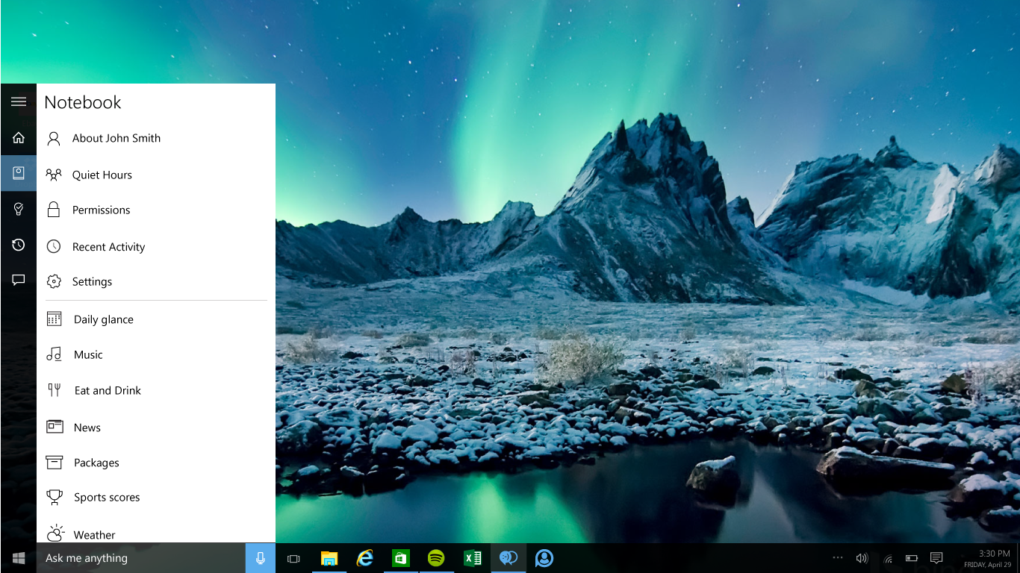

Slide 75
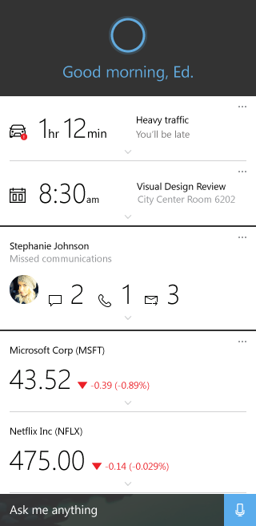
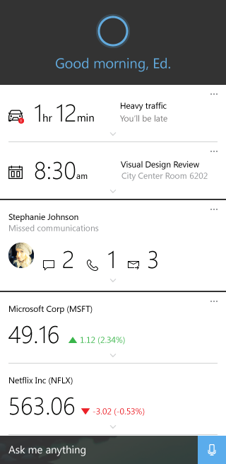
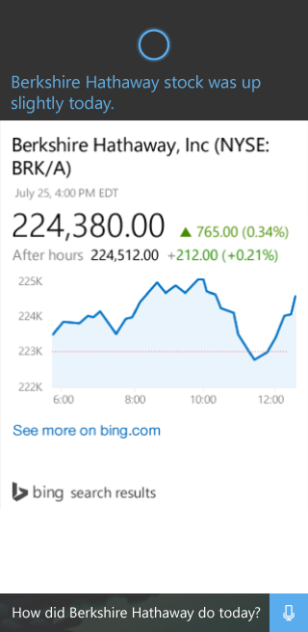
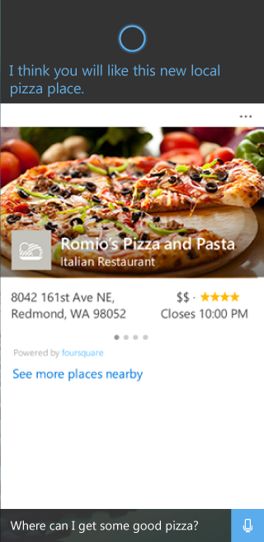

Slide 76
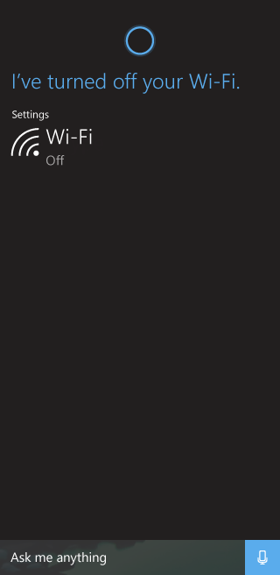
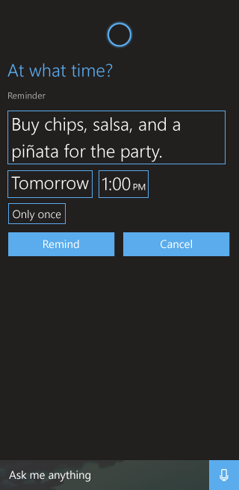
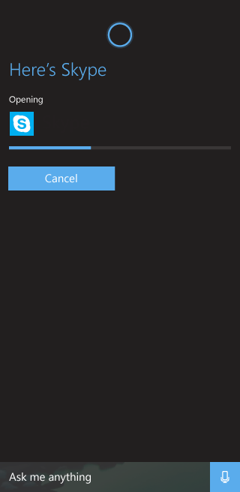

Slide 77
Cortana Extensibility
Deep linking to app scenarios
Completing tasks in Cortana
Finding information quickly

Slide 78
Voice Commands for Universal Windows Apps
Deep linking with Foreground Voice Commands
Universal Apps can register to handle Cortana voice commands directed at their app
When users speak these commands, Cortana activates the app with the spoken context
Apps trigger scenarios based on this context
Available for Universal Windows Apps built with XAML and JavaScript

Slide 79

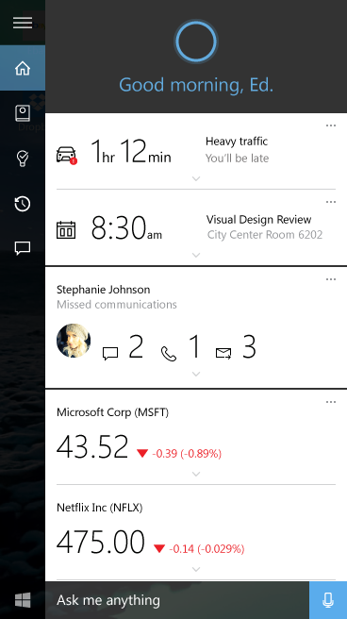

Foreground Voice Commands Architecture
Adventure Works, show my trip to London
Application Code
Adventure Works
X
Call
7
Text
2
Remind
Email
Voice Command
Voice Command Definition (VCD)
1
3
6
Windows Speech
Platform (on-device)
4
Microsoft Speech
Platform Service (cloud)
5

Slide 80
Demo: Deep Linking with Voice Commands

Slide 81
Voice Command Definition
<Command Name=“showTripToDestination">
<Example>Show my trip to San Francisco</Example>
<ListenFor>show [my] trip to {destination}</ListenFor>
<Feedback>Looking for trip to {destination}</Feedback>
<Navigate/>
</Command>
<Command Name=“showTripToDestination">
<Example>Show my trip to San Francisco</Example>
<ListenFor>show [my] trip to {destination}</ListenFor>
<Feedback>Looking for trip to {destination}</Feedback>
<Navigate/>
</Command>
Command
Logical unit of user “intent”. Contains …
… What the user says to Cortana
… What Cortana says in response
… What action Cortana will perform, i.e.
<Navigate/> element indicates it is a foreground voice command
Next Steps:
Register VCD with Windows.ApplicationModel.VoiceCommands.VoiceCommandDefinitionManager
Override App.OnActivated() and launch your scenario based on context passed as name/value pairs

Slide 82
Demo: Cortana + Windows Web Apps

Slide 83
Voice Commands for Windows Web Apps
Deep linking with Voice Commands for Windows Web Apps
Windows Web Apps can take advantage of VCD-based App activation with little effort.
Simply drop a VCD file on your website, add a meta tag to the HTML pointing to the VCD.

Slide 84




Completing tasks in Cortana
Here are your upcoming trips.
Text-To-Speech (TTS)
Introducing new capabilities that enable apps to complete tasks within Cortana.
Capabilities include:
APIs for task workflow
UI templates
Speech interactivity model
App Screen
A
App Icon
Here are your upcoming trips.
App GUI Text
Las Vegas
Content Tile
May 14th 2015
San Diego
Content Area
May 28th 2015
Phoenix
August 24th 2015
Link to your app
Go to Adventure Works

Slide 85





Project Astoria
Build a Windows app with your Android code
Your Android Code
(Project Astoria SDK & App analysis)
Your IDE
(Project Astoria Plugins)
Your dev
machine
Windows
Magic
Your app in the Windows Store
IntelliJ
Android
Studio
Eclipse
Live tiles
Windows
Mac
+
+
+
…
Windows 10 Mobile Only

Slide 86





Windows does the heavy lifting for you
We translate and redirect Android concepts to Windows concepts
Sharing
Notifications
File system
Camera
User experience
Cloud services
Platform
Acquisition
Input and interaction
App-to-app interactions
Windowing & navigation
Notifications and live tiles
…
In-App Purchases
Ads
Maps
Game Services
Analytics
Notification service
…
File system
Contacts, photos,…
Sensors
Camera
Hardware accelerated graphics & Direct X
…

Slide 87





User experience
User experience
Cloud services
Apps built with Project Astoria are Windows apps
Platform
Contoso
Users acquire apps built with Project Astoria through the Windows Store

Slide 88










User experience
User experience (cont’d)
Cloud services
Apps built with Project Astoria are Windows apps
Platform
v/s
v/s
v/s

Slide 89

User experience
Cloud services
Cloud services
Windows apps built with Project Astoria use Microsoft cloud services
Platform
Microsoft Services
AppInsights
MS Ads
In-app Purchases
Windows Notification Service
Xbox Live Services
Bing Maps
Windows Location services
…
Project Astoria SDK in Java
Use Microsoft services with minimal code change
Get Started in Dev Center

Slide 90
User experience
Platform redirection
Cloud services
Android platform capabilities are redirected to Windows
Platform
APPX
APK
File system
Contacts, photos,…
Sensors
Camera
Hardware accelerated graphics & Direct X
Networking/sockets
Application lifecycle
Resource management
Background execution model
Security model
“PROJECT ASTORIA” SUBSYSTEM
WINDOWS

Slide 92
Microsoft Edge for Developers
Why Microsoft Edge?
Edge Supports the Modern Web
Managing Compatibility
Developer Tools

Slide 93
1995
2015
1
2
3
4
4.x
5
5.5
6
7
8
9
9
10
11
Trident

Slide 94

HTML4, ES3, CSS2
1995
1995
2015
1
2
3
4
4.x
5
5.5
6
7
8
9
9
10
11
Trident
Quirks
Strict
!DOCTYPE
Notes:
Even as long ago as IE6, we had to worry about adding new features while keeping backward compat
We use the “doctype” as a trigger to use the strict mode
DOCMODE is: a compat flag that turns on and off features in the SAME engine
(dozen “if” in the code, if IE9 or IE8 etc….)

Slide 95

HTML4, ES3, CSS2
CSS2.1
1995
2015
1
2
3
4
4.x
5
5.5
6
7
8
9
9
10
11
Trident
!DOCTYPE
IE5
Quirks
IE7
Compatibility View
IE8
Standards Mode
x-ua-compatible
Notes:
We took this concept further and add an IE8
3 DOCMODES inside the same engine

Slide 96

Modern Web
HTML5, SVG, ES5, CSS3
Legacy Web
CSS2.1
HTML4, ES3, CSS2
1995
2015
1
2
3
4
4.x
5
5.5
6
7
8
9
9
10
11
Trident
IE5
Quirks
IE7
Compat View
IE8
Standards Mode
EMIE
Enterprise Mode
!DOCTYPE
x-ua-compatible
IE9
Standards Mode
IE10
Standards Mode
QME
Quirks Mode Emulation
IE11
Standards Mode
Notes:
We knew it was a problem but our focus was compat for users

Slide 97
In the meantime…
Blink
Chrome, Firefox, Opera and Safari are evergreen
Updated frequently
No need to support different document modes

Slide 98

Microsoft Edge
Microsoft EdgeHTML
Evergreen
Notes:
No new document mode
Will be update on a fast pace
We forked trident and created Edge

Slide 99
“Legacy” IE
Browser
“Document Modes”
IE5
IE7
IE8
IE9
IE10
IE11
Core OS
Notes:
So much compatibility cruft in IE. Was a drag on innovation. Lots of bloat. Lots of attack surface area.

Slide 100
Microsoft Edge – for the modern web
Microsoft Edge
Internet Explorer 11
New Rendering Engine
(EDGEHTML.DLL)
Legacy Rendering Engine
(MSHTML.DLL)
New JavaScript Engine
(CHAKRA.DLL)
Legacy JavaScript Engine
(JSCRIPT9.DLL)
Core OS

Slide 101

Notes:
Goals:
Fast, same engine on multiple devices, Iterates quickly, standards compliant, interoperable, can rev with the modern web

Slide 102
Shifting our focus to interop with EdgeHTML
Notes:
If it works in Chrome and Firefox it should work in Edge

Slide 103




User-Agent Strings
Mozilla/5.0 (Windows NT 10.0; WOW64; rv:39.0) Gecko/20100101 Firefox/39.0
Mozilla/5.0 (Macintosh; Intel Mac OS X 10_10_1) AppleWebKit/600.1.25 (KHTML, like Gecko) Version/8.0 Safari/600.1.25
Mozilla/5.0 (Windows NT 10.0; WOW64) AppleWebKit/537.36 (KHTML, like Gecko) Chrome/44.0.2403.107 Safari/537.36
Mozilla/5.0 (Windows NT 10.0; Win64; x64) AppleWebKit/537.36 (KHTML, like Gecko) Chrome/42.0.2311.135 Safari/537.36 Edge/12.10240

Slide 104
User-Agent Strings
Mozilla/5.0 (Windows NT 10.0; WOW64; rv:39.0) Gecko/20100101 Firefox/39.0
Mozilla/5.0 (Macintosh; Intel Mac OS X 10_10_1) AppleWebKit/600.1.25 (KHTML, like Gecko) Version/8.0 Safari/600.1.25
Mozilla/5.0 (Windows NT 10.0; WOW64) AppleWebKit/537.36 (KHTML, like Gecko) Chrome/44.0.2403.107 Safari/537.36
Mozilla/5.0 (Windows NT 10.0; Win64; x64) AppleWebKit/537.36 (KHTML, like Gecko) Chrome/42.0.2311.135 Safari/537.36 Edge/12.10240

Slide 105
Detecting Microsoft Edge
Mozilla/5.0 (Windows NT 10.0; Win64; x64) AppleWebKit/537.36 (KHTML, like Gecko) Chrome/42.0.2311.135 Safari/537.36 Edge/12.10240
"Edge/"

Slide 106
Aliasing webkit- prefixed APIs
-webkit-align-content
-webkit-align-items
-webkit-align-self
-webkit-animation
-webkit-animation-delay
-webkit-animation-direction
-webkit-animation-duration
-webkit-animation-fill-mode
-webkit-animation-iteration-count
-webkit-animation-name
-webkit-animation-play-state
-webkit-animation-timing-function
-webkit-appearance
-webkit-backface-visibility
-webkit-background-clip
-webkit-background-origin
-webkit-background-size
-webkit-border-bottom-left-radius
-webkit-border-bottom-right-radius
-webkit-border-image
-webkit-border-radius
-webkit-border-top-left-radius
-webkit-border-top-right-radius
-webkit-box-align
-webkit-box-direction
-webkit-box-flex
-webkit-box-ordinal-group
-webkit-box-orient
-webkit-box-pack
-webkit-box-sizing
-webkit-column-break-after
-webkit-column-break-before
-webkit-column-break-inside
-webkit-column-count
-webkit-column-gap
-webkit-column-rule
-webkit-column-rule-color
-webkit-column-rule-style
-webkit-column-rule-width
-webkit-column-span
-webkit-column-width
-webkit-flex
-webkit-flex-basis
-webkit-flex-direction
-webkit-flex-flow
-webkit-flex-grow
-webkit-flex-shrink
-webkit-flex-wrap
-webkit-justify-content
-webkit-keyframes
-webkit-order
-webkit-text-size-adjust
-webkit-transform
-webkit-transform-origin
-webkit-transform-origin-x
-webkit-transform-origin-y
-webkit-transform-origin-z
-webkit-transition
-webkit-transition-delay
-webkit-transition-duration
-webkit-transition-property
-webkit-transition-timing-function
-webkit-user-select
Notes:
Lots of sites use webkit prefixed apis, even when an open standard exists. So, we render them correctly, mostly by just aliasing them to the standards compliant behavior

Slide 107
Removing the legacy of Internet Explorer
220k+
Unique LoC Removed
6 document modes
300+ APIs removed
300k+
Unique LoC Added
49 New Major Features
4200+ Interop Fixes
http://aka.ms/cdbcjp
Notes:
Lots of sites do feature detection on these APIs to determine it is IE. A lot if it is old, fragile code. It is where attackers would go to find security holes. Still supported in the legacy engine. Usually not used on the public web.

Slide 108
Technologies and APIs NOT supported in Edge
ActiveX
Browser Helper Objects
Document Modes
Vector Markup Language (VML)
VBScript
attachEvent / removeEvent – use addEventListener
currentStyle – use getComputedStyle
Conditional Comments
IE8 Layout quirks – use Enterprise Mode if necessary
DirectX filters and transitions – use CSS3 & SVG
AND MUCH MUCH MORE
See here: https://blogs.windows.com/msedgedev/2015/05/06/a-break-from-the-past-part-2-saying-goodbye-to-activex-vbscript-attachevent/
Notes:
https://blogs.windows.com/msedgedev/2015/05/06/a-break-from-the-past-part-2-saying-goodbye-to-activex-vbscript-attachevent/
IE proprietary tech has been eschewed for standards compliant tech

Slide 109
Building for the web of today and tomorrow

Slide 110



Standards

Slide 111
Security and Reliability
New standards support
Content Security Policy (CSP)
HTTP Strict Transport Security (HSTS)
HTTP 2.0
Overhauled DOM memory representation
Removed binary extensions
No more ActiveX controls
No Toolbars, BHOs, VML, VBScript
Secure sandbox
Enhanced Protected Mode with AppContainer
64-bit by Default
New memory management
MemGC
Control Flow Guard (CFG)
Fail-fast
Abandonment
if (this == nullptr) {
return;
}
http://aka.ms/lvwo37

Slide 112

Planning in the open
https://status.modern.ie/

Slide 113

Web developer feedback
http://uservoice.modern.ie/

Slide 114

New web developer portal site
http://aka.ms/MSEdgeDev

Slide 115
Performance
Source: “Examining Microsoft Edge Browser Performance”, AnandTech, 21 July 2015
http://aka.ms/phdlae

Slide 116

Support for experimental features
about:flags

Slide 117

F12 Developer Tools

Slide 118

Enterprise Mode Site List Manager
Provides Enterprises a way to manage their legacy web apps
Configure web sites to open in IE11 with specific document modes
Sets via policy
Notes:
Site compatibility list gets exported to xml and hosted on a web server or file server
IE Policy can be set to download this list whenever IE launches
We testing on site lists in excels of 20K entries
See here: https://channel9.msdn.com/Events/Ignite/Microsoft-Ignite-New-Zealand-2015/M336

Slide 119


Slide 120
Next Steps:
Start Here:
https://dev.windows.com/en-us/downloads/windows-10-developer-tools
Get Windows 10: http://microsoft.com/windows
Get Visual Studio 2015: http://aka.ms/vs2015ce
MVA video series:
http://aka.ms/mva-win10-dev

